Slide 1
Mail Entry Roadmap
National PCC Week
Lance Bell
Program Manager, Business Mailer Support HQ

Slide 2
Agenda
Mail Entry Roadmap
Reviews Postal Service’s key initiatives to streamline the
acceptance, induction, and verification of commercial
mailings.
Electronic Documentation (eDoc)/Mail Quality measured over a calendar month
Full-Service
eInduction
Seamless
Mail Entry Roadmap
2
Notes:
Agenda – We are now going to measure quality of a particular calendar month

Slide 3
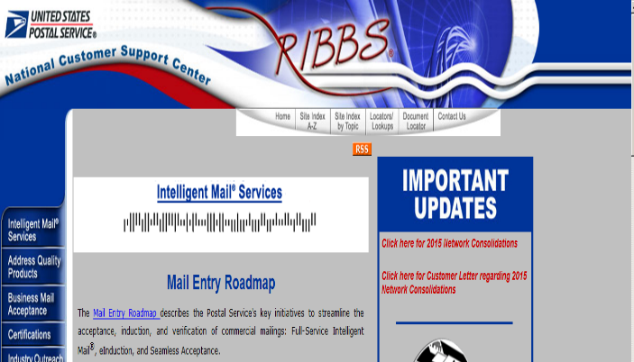
Top Resource
Located at Ribbs.usps.gov
Mail Entry Roadmap
Rapid Information Bulletin Board System (RIBBS)
3

Slide 4
Full-Service
Full-Service Intelligent Mail is for letters, cards, and flats prepared as First-Class Mail®, Periodicals, Standard Mail®, and Bound Printed Matter.
Mailings submitted using eDoc (Mail.dat, Mail.XML, Postal Wizard)
Unique Intelligent Barcodes for Containers, Trays, Pieces
78% of commercial volume is on Full-Service
Mail Entry Roadmap

Slide 5
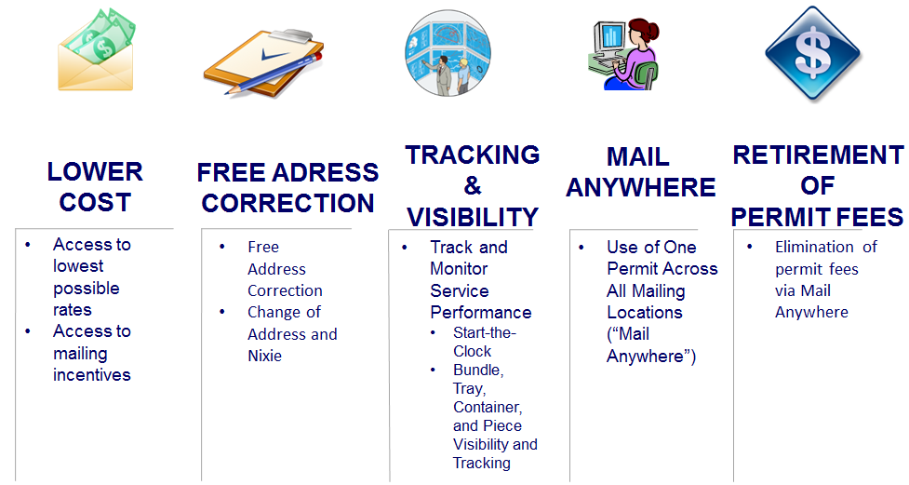
Full-Service Benefits
Mail Entry Roadmap
Notes:
Mailer anywhere – can use a single permit across all mailing locations – Fact Sheet on RIBBS that details the Mail Anywhere and requirements – I strongly encourage you to

Slide 6
BMEU Outreach
BMEU outreaching to customers to migrate to Full-Service
No mandate for mailers to submit eDoc or Full Service
Certified Software Vendors
https://ribbs.usps.gov/uniqueimb/documents/tech_guides/VendorFullServiceCapabilities.pdf
Certified Mail Service Providers
https://ribbs.usps.gov/intelligentmail/documents/tech_guides/MSP_MailOwnerInformationalSheet.pdf
Postal Wizard at BME
Assist customers in signing up to Business Customer Gateway
Mailers enter hard-copy postage statements into Postal Wizard
Self-Service Terminal
Mailers Check-in Mailings
Scan confirmation page to check-in (available for all eDoc)
Mail Entry Roadmap
Notes:
2 mail vendors and providers and the USPS has certified those products to be FS compliant. Go to the Facts sheets on RIBBS know the vendors.
Airport terminals – How can we help our customers move their mail faster – so the USPS went with the self service terminal.

Slide 7
Mail and eDoc Quality
Mail Entry Roadmap

Slide 8
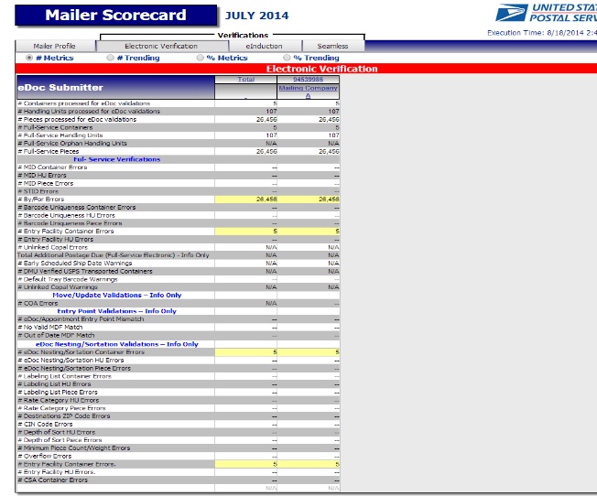
Mailer Scorecard
Mailer Profile, Electronic Verification eIndcution, Seamless
Results aggregated over 1 month
Measured against established thresholds
Mail Entry Roadmap
Notes:
Now that we are moving into the world of mail quality monitoring in a calendar month the Mailer scorecard was developed. How many here are already aware of the scorecard?

Slide 9
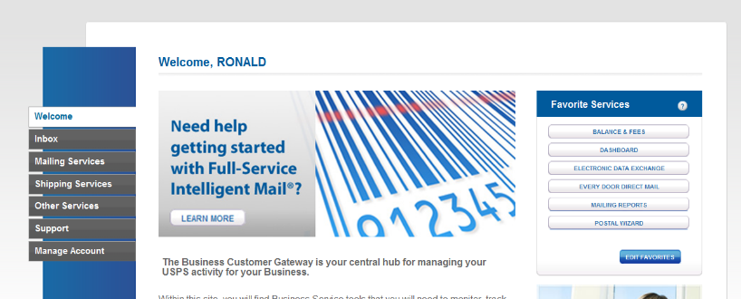
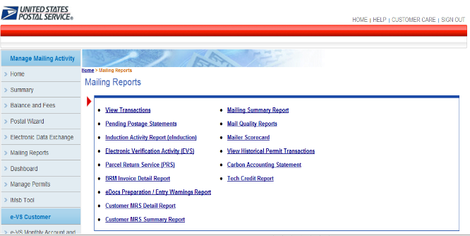
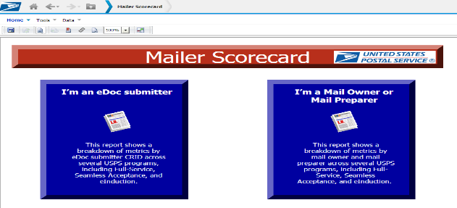
Accessing Mailer Scorecard
Mail Entry Roadmap
Notes:
Review of how to access the scorecard through BCG

Slide 10
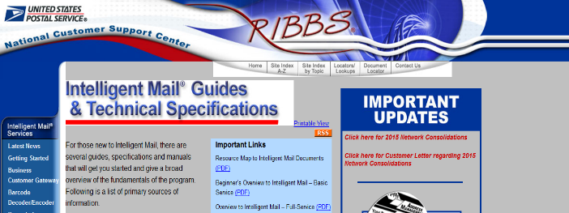
Mailer Scorecard Resources
Located at Ribbs.usps.gov
Intelligent Mail Guides & Technical Specifications
Mail Entry Roadmap
Rapid Information Bulletin Board System (RIBBS)

Slide 11
Full-Service Milestones
August 2014
New Scorecard Version
MOVE Update & eDoc Nesting Sortation Reporting
October 2014
Full-Service Calculations Visible/Review Only
November 2014
Expand Non-Profit Identification in eDoc
January 2015
FS Postage Assessments Only
MOVE Update Calculations Visible/Review Only
April 2015
MOVE Update Postage Assessments
Mail Entry Roadmap
Notes:
Move Update and Nesting Sortation have been added to the electronic verification tab. In November we are going to expand the non-profit identification in eDoc. MV Update compliance is monitored .8% - Is based off of the fact it is now a census. In a sampling world we had a higher percentage because it was one mailing and depending on the volume….We looked at 3 months of data and with doing that there were three focus points at what point statistically of what percentage is equal to all the volume and the quality of customers with move update and the data shows .8% is 2 standard deviations from where the national quality is with move update. Against the quality against all mailers over a three month period. There will be a federal register notice will be published soon to give customers the opportunity to respond to the move update threshold once it is published. April is the proposed date that customers would be assessed for move update errors.
Calculations are the invoice amounts and assessments will begin in January 2015.
If the DMU redirection is mentioned – The company has made the decision, the Detached Mail Units provided have become more costly. The processes we have talked about we are gaining efficiencies by getting visibility of the mail if we have customers who cannot get to 75% full-service we have to look at taking those privileges away because it is no longer efficient unless you are submitting Full-Service. Now if customers are taking the right steps we are going to work with you, we will not just shut the door.

Slide 12
Full-Service Verifications
Error Type | What is it? | Threshold
Valid MID | Is the Mailer ID in the Intelligent Mail container barcode valid and registered with the Postal Service? | 2%
 | Is the Mailer ID in the Intelligent Mail tray barcode valid and registered with the Postal Service? | 2%
 | Is the Mailer ID in the Intelligent Mail barcode valid and registered with the Postal Service? | 2%
Valid STID | Is the Service Type ID in the Intelligent Mail barcode valid and correct for the class and service level of the mailpiece? | 2%
By/For | Is the mail owner and mail preparer identified in the eDoc and accurate? | 5% *
Unique Barcode | Is the Intelligent Mail container barcode unique across all mailings from all mailers over the previous 45 days? | 2%
 | Is the Intelligent Mail tray barcode unique across all mailings from all mailers over the previous 45 days? | 2%
 | Is the Intelligent Mail barcode unique across all mailings from all mailers over the previous 45 days? | 2%
Entry Facility | Is the entry facility a valid the Postal Service location? | 2%
Unlinked Copal | Was a tray/virtual Sack marked for co-palletization at origin and no electronic documentation is submitted with the tray/virtual sack on a pallet? | 5%
Mail Entry Roadmap
Notes:
There are at no time is any physical mail scanned or reviews of the mailpiece do those actions have an impact on the Full-Service tab. This is an eDoc verification.
Threshold was set on where we saw national averages across all customers. We moved regular threshold away from the normal. The MID that is in the eDoc at the container piece and tray level and is that MID registered with the Postal Service. At this point we are not checking to see if it is the correct MID.
STID listed in the eDoc is the appropriate three digit code for the class and processing category for the mailing.
By/For is the mail preparer and mail owner identified correctly in the eDoc. Caveat – if a mailer has more than 5% of customers who’s mailings are less than 5k pieces a day can request a customized threshold. So if you are a presort mailer and most of your customer give you less than 5k a day what would you set your threshold at? (100%)
Barcode Uniqueness – Container Tray piece – 45 day uniqueness against every eDoc. We do not limit our uniqueness checks to simply looking at a specific eDoc submitter.
Entry Facility – is a valid Facility ID listed within eDoc
CoPalletization – Did the mailer and the consolidator submit eDoc and did it have an OCI file submitted within 14 days of the postage statement.

Slide 13
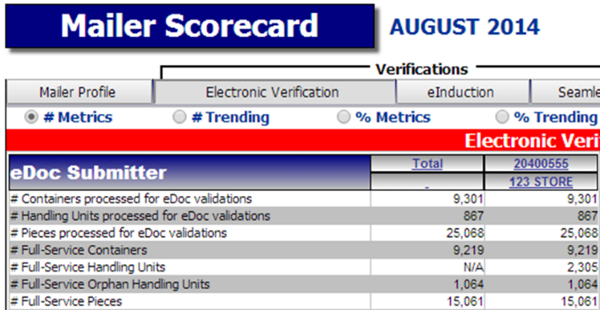
Mailer Scorecard Electronic Verification Tab – Section 1
1. Volume Information: Provides the count of container, handling units, and pieces that were provided in eDoc and included in the verification results on this tab.
Mail Entry Roadmap
Microstrategy Reports
Notes:
FS Volume – All eligible FS Volume as denominator – How much mail have you submitted and how much was FS? – Carrier route mail – Is it eligible? – technical conversations – Interpretation of DMM Carrier Route Flat was eligible for unique barcodes so it was included in the denominator. The DMM was identified in being incorrect. The DMM has to be adjusted to eliminate the carrier route to be in eligible. So we need an update on whether this has been completed.

Slide 14
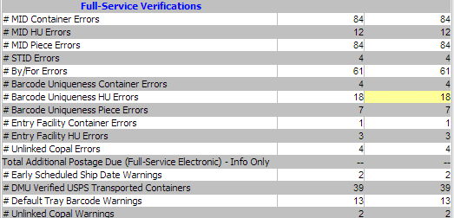
Mailer Scorecard Electronic Verification Tab – Section 2
2. Full-Service Verifications: These verifications compare the eDoc against the full-service preparation requirements for full-service mailings.
Mail Entry Roadmap
Microstrategy Reports
Notes:
FS Volume – All eligible FS Volume as denominator – How much mail have you submitted and how much was FS? – Carrier route mail – Is it eligible? – technical conversations – Interpretation of DMM Carrier Route Flat was eligible for unique barcodes so it was included in the denominator. The DMM was identified in being incorrect. The DMM has to be adjusted to eliminate the carrier route to be in eligible. So we need an update on whethere this has been completed.

Slide 15
Full-Service Verifications
October 2014: Create informational only postage assessment for full-service verification failures over the threshold
Generated 10 days after the end of the month
Only when threshold is exceeded across all mailings submitted in the calendar month
Based on September mailings
January 2015: Begin assessing mailers for the full-service discount amount for full-service verification failures over the threshold
Mail Entry Roadmap
Notes:
Assessment report process. Only when pieces exceed that threshold will the invoicing process occur. In October the figures will be based on September mailings.

Slide 16
Mailer Scorecard Electronic Verification Tab – Section 3
3. Move-Update Validation: This validation will replace the MERLIN Move-Update verification for mailers providing more than 75% of their volume as full-service.
Mail Entry Roadmap
Microstrategy Reports
Notes:
Replaces MERLIN – based on mailers who provided us more than 75% of their volume. Once a customer exceeds 75% the customer will be moved to the census monitoring. If a customer drops below the threshold we will not revert back to MERLIN. Prior to reaching the 75% volume threshold we will continue with the MERLIN process. When the customer hits the threshold – although they may still have MERLIN verifications performed on mailings the Move-Update verification functionality will be shut off for that customer.

Slide 17
Move-Update Validation
August 2014: Provide mailers metrics on Move-Update validation
Mailers with more than 75% of eligible volume in full-service
Change-of-Address records filed/effective more than 95 days before the mailing date will be in error
January 2015: Create informational only postage assessment for Move-Update verification failures over the threshold
April 2015: Postage assessment for Move-Update verification failures over the threshold
Sub-Bullet (Arial bold, square, 75% of font size) Text (Arial bold, 20-24 pt.)
Mail Entry Roadmap

Slide 18
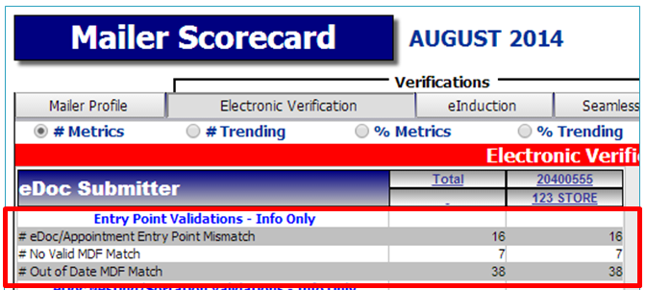
Mailer Scorecard Electronic Verification Tab – Section 4
4. Entry Point Validations: This validation checks the correctness of the Postal Service entry facility in the doc for mailers providing more than 75% of their volume as full-service.
Mail Entry Roadmap
Microstrategy Reports
Notes:
Presort from an eDoc perspective –
Entry point – Checks correctness in eDoc of mailers who are submitting more than 75% volume FS – we will not assess this in January.

Slide 19
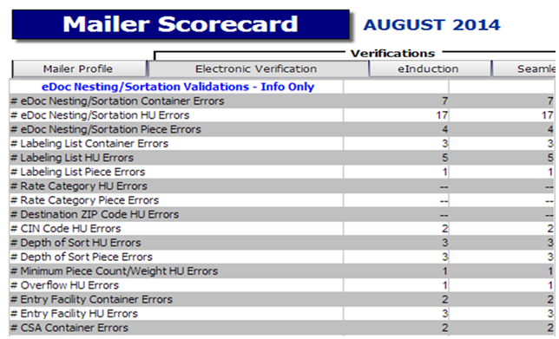
Mailer Scorecard Electronic Verification Tab – Section 5
5. eDoc Nesting/Sortation Validations: This validation checks the presort in the eDoc against labeling lists and presort rules for mailers providing more than 75% of their volume as full-service.
Mail Entry Roadmap
Microstrategy Reports
Notes:
Nesting Sortation – eDoc validation where we literally look at container handling unit and piece level and check against the labeling list to validate the accuracy – We will not be assessing this process in January.

Slide 20
Electronic Verification Tab – Section 5
eDoc Presort Validation
August 2014:
eDoc is checked against presort rules such as minimum piece counts and required sortation levels, active labeling lists, and the Mail Direction File (MDF)
Mailers with more than 75% of eligible volume in full-service
Mailer Scorecard Error | What is it?
Entry Point Validation | Is the entry point in the eDoc valid for the container – specifically looking at the container destination ZIP code and the entry discount? This validation checks the entry location based on data in effect on the postage statement mailing date. This validation checks eDoc against the Mail Direction File. .
eDoc Nesting/Sortation | Were the bundles, trays, sacks, or containers in the eDoc created as required by the labeling lists in use on the postage statement mailing date? This validation includes checks for use of labeling lists, depth-of-sort, minimum piece counts and weights, and rates paid.
Mail Entry Roadmap
Microstrategy Reports

Slide 21
Non-Profit Eligibility
Receiving nonprofit rates today
Paying on paper postage statement: Provide list of nonprofit authorization numbers to clerk
Paying through eDoc: Either the Mail Owner Permit or Paying Permit have to be linked to a nonprofit authorization
Receiving nonprofit rates in November 2014
Paying through eDoc: Expanded options to provide nonprofit authorization
Any combination of the Mail Owner MID, Mail Owner CRID, Mail Owner Permit Number, or Paying Permit can be linked to nonprofit authorization
Mail Entry Roadmap
Notes:
In November we are expanding our options on how customers can provide their information to us as to whether they are eligible or not for non profit rates.
Today – Customers provide non-profit information and the clerks looks up to see if they are eligible by utilizing PostalOne!
If you are submitting eDoc the mail owner is identified.
For all non profit mailers in a particular mailings and combination of the mid crid permit or payment permit can be linked to the non – profit – this is sort of the By/For for non profit.
We are not yet retiring ghost numbers. (need validation)

Slide 22
eInduction
The electronic Induction (eInduction) process streamlines the preparation and induction of drop shipments and expedited plant load mailings. It leverages existing electronic documentation (eDoc), Intelligent Mail container barcode (IMcb), and handheld scanner technologies to verify payment and preparation of commercial mail containers.
Mail Entry Roadmap

Slide 23
eInduction
Scan-Based Paperless Entry at Dock
Use eDoc & scanners to accept container at entry
Automated decision making
Save time at origin and at entry by streamlining process
Mail Entry Roadmap
Notes:
eInduction – in Oct 2013 it was deployed right now 30% of containers are eInduction – In August there are new reporting functionality – We still have processing facilities do not have surface visibility standards. We have scanning capabilities 82% of the volume we receive PVDS are entered through facilities that have SV. We want to expand so we are piloting now in September at non SV sites.

Slide 24
eInduction
October 2013
Deployed
30% of PVDS containers inducted through eInduction
August 2014
New Reporting Functionality
September 2014
Pilot new functionality for facilities w/o scanning capabilities
(Non-SV, DDUs)
Manual Postage Assessment against Egregious Thresholds
Summer 2015
Automated Postage Assessment
Mail Entry Roadmap

Slide 25
eInduction
Non-Surface Visibility Solution
Improving eInduction process at sites without Surface Visibility
USPS clerks scans the IMcb and collects appointment data where applicable
Reconcile scan with eDoc post-induction
September 2014: Pilot scan-based process at non-SV processing facilities, hubs, and DDUs
National deployment date will be determined based on pilot results
Mail Entry Roadmap
Notes:
They have to link containers to an appointment or provide a paper 8125 Pilot allows us to use a cradle device. (SV is wireless) information is only passed with our system when its cradled. So containers will be validated on the back end.
We will use our scanners to capture the barcode on the containers and allow them to be processed. Then once cradled we will match it up with what was submitted through eDoc to account for containers submitted. So the mailer is just required to have an appointment not required to have appointment in eDoc if you are not in eInduction. If you are participating in eInduction you have to tie it to a FAST appointment. Appointments not required at DDU level at this time. No mandate in site. This solution is intended to make is easier for mailers to become paperless.

Slide 26
eInduction
Non-Surface Visibility Solution
Error | Mailer Contact Threshold | Egregious Threshold | What is it?
Payment | 0.00% | 0.00% | Did the mailer submit an eDoc with the appropriate amount of payment?
Misshipped | 1.05% | 2.00% | Did the mailer induct the container at the correct location per the eDoc?
Duplicate | 0.17% | 0.33% | Did the mailer apply unique barcodes to each container within a 45-day period?
Zone | 0.01% | 0.02% | Based on how far the container traveled relative to the origin, did the mailer earn the zone discount claimed on the eDoc?
Mail Entry Roadmap
Notes:
Changes in scorecard – egregious threshold

Slide 27
eIndcution Resources
Located at Ribbs.usps.gov
Intelligent Mail Guides & Technical Specifications
Mail Entry Roadmap
Rapid Information Bulletin Board System (RIBBS)

Slide 28
Seamless Acceptance
Seamless Acceptance leverages electronic documentation and Intelligent Mail barcodes on mailpieces, trays and sacks, and containers to automate acceptance and verification processes. Mailpiece scans collected from mail processing equipment (MPE) and hand held scanning devices are reconciled to the mailer electronic documentation (eDoc) to confirm proper mail preparation for the discounts claimed and postage paid.
Mail Entry Roadmap

Slide 29
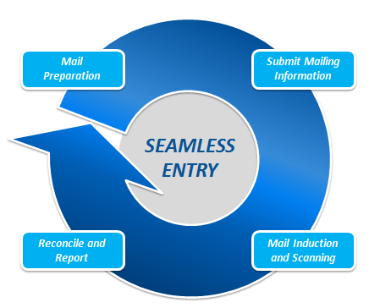
Seamless Acceptance
Seamless Process Overview
Mailer submits eDoc
Statement auto-finalized
Capture sampling data using handheld scanner
Capture data from Mail Processing Equipment (MPE) scanning
Compare data captured to eDoc
Detailed Mail Quality reporting
Mail Entry Roadmap

Slide 30
Seamless Acceptance
Verification | What is it?
Undocumented | Was every piece scan from a mailer participating in Seamless Acceptance able to be matched to eDoc?
Delivery Point | Is the delivery point contained in the IMb valid for the service level of the mailpiece? In August 2014, there will be a logic correction to stop logging DPV errors when there is a valid match on a lower level delivery point (ex: 11 digit delivery point has a 9 digit match).
Nesting/Sortation (MPE) | Were the mailpieces placed in a different tray or bundle than indicated in the eDoc? This verification uses MPE scans to identify how the mail was physically prepared.
Nesting/Sortation (Sampling) | Were the mailpieces placed in a different tray or bundle than indicated in the eDoc? Or was the tray/sack placed on a different container than indicated in the eDoc? This verification uses sampling scans to identify how the mail was physically prepared.
Mail Entry Roadmap

Slide 31
Seamless Acceptance
Verification | What is it?
Postage | Is the type of postage payment and the amount of postage affixed match the eDoc for the mailpiece? This is a sampling verification.
Weight | Is the weight of the mailpiece different than the weight indicated in the eDoc? Is this difference enough to cause a change in the amount of postage due? This is a sampling verification. The Postal Service is working with the industry to establish the threshold for environmental factors for pound postage.
Mail Characteristic | Does the mailpiece match the same mail class and processing category as indicated in the eDoc? Does the piece content quality for nonprofit or standard mail rates (as appropriate)? This is a sampling verification.
Barcode Quality | Was a mailpiece sampled that didn’t have a scannable barcode in an automation mailing?
Mail Entry Roadmap

Slide 32
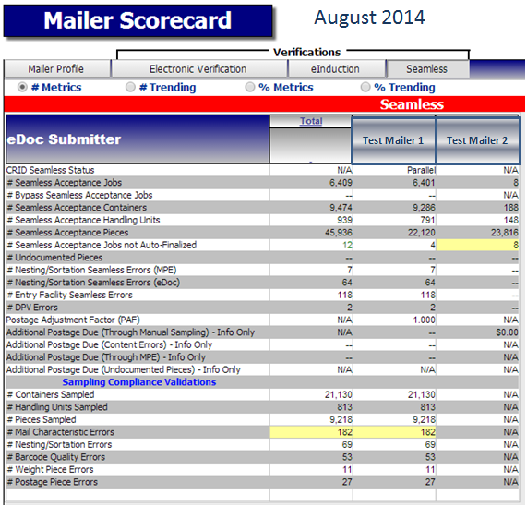
Seamless Acceptance
Mailer Scorecard

Slide 33
Seamless Acceptance Milestones
March 2014
Seamless Acceptance Deployed
Manual Postage Assessment against Egregious Thresholds
August 2014
Enhanced Undocumented Reporting
15% of Commercial Volume on SA
November 2014
Expand Non-Profit Identification in eDoc
January 2015
Postage Assessment Calculations Visible/Review Only
April 2015
Automated Postage Assessments

Slide 34
Questions

