Slide 1

Show Your ROI
Through Your PCC
December 6, 2013
Amy Rocha John Keller
Industry Co-Chair Postal Co-Chair

Slide 2
Industry - Getting an ROI
Opportunities for Business Development
  Networking
  Connections to “the right people”
  Value of Strategic Partnership
  Knowledge/Training Programs
  Webinars

Slide 3
Industry - Getting an ROI
“Involvement with local USPS executives and mailers played a significant role in building a positive relationship with and recognition in the industry. Working on the Executive Board all these years demonstrated my concern for the success of the mailing industry and the PCC was the vehicle that made that a reality for me.”
Wanda Senne
World Marketing, Inc.

Slide 4
Industry - Getting an ROI
“ Having invented the Postage Meter in 1901 Pitney Bowes has always had a special relationship with the USPS. Our company believes so strongly in the foundation and business opportunity that the Post Office offers to companies large and small that many PB employees serve on the local PCC such as I do for Tampa Bay. As both a PCC sponsor and a board member I have seen businesses flourish and grow their business by leveraging all that the USPS offers. Most customers tell me that the educational part alone is one of the greatest benefits of being a member. Not only do most say they reduce their costs of getting their message to their potential customers but they are able to reach more of them!
Paul Briody
Pitney Bowes

Slide 5
Postal - Getting an ROI
Opportunities for Business Development
  Translate Business Needs to Postal Products
  Develop Long-Term Relationships
  New Products
  Improve communication with customers which promotes shared technologies, trends, and business practices.
  Taylor existing products and services to meet the customer needs.

Slide 6
Postal - Getting an ROI
“I highly recommend postal people getting involved, with their manager’s blessing of course, for most of the reasons below. (Training, gaining leadership experience, keeping up to date on what’s happening, ability to invite customers to no and low cost programs.) Postal people need opportunities to listen to our customers and work on solutions to keep the mailing industry healthy and growing.”
Sharon Owens
Manager, Industry Engagement and Outreach
National PCC Co-Chair

Slide 7
Education
Local PCCs
Regional
National
Certificates and Certification available!

Slide 8
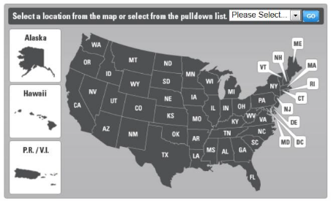

Local PCCs
The Postal Customer Council® (PCC®) program is a valuable resource for business mailers, large and small. Local PCCs serve as an open channel for USPS-to-business communication, providing information and best practices for cost-effective and profitable mailing, education and training, and solving local challenges. Though most PCC members include large business mailers, government agencies, and business mail service providers, small businesses can benefit from PCC membership, too.
https://www.usps.com/business/local-pcc.htm

Slide 9
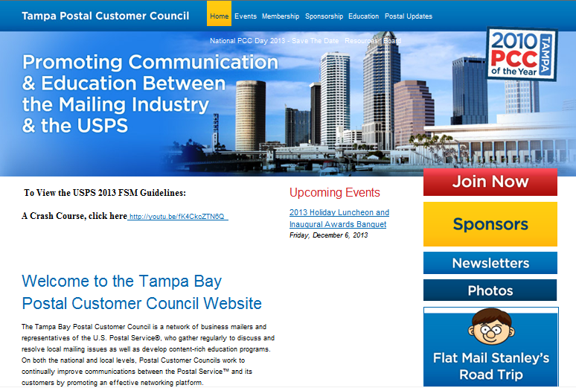
Local PCCs
http://www.tampapcc.org/

Slide 10
Local PCCs
The Premier PCC Program provides PCCs with a set of national standards that serve as benchmarks for PCC excellence.
Based on the national standards, PCCs are
recognized for performing at a Bronze, Silver, or Gold Level of excellence.
In 2013 a new award “Prestigious Platinum”
was approved for PCCs that have achieved the Gold Level for five consecutive years. The Tampa Bay PCC was honored to receive this prestigious award.

Slide 11
Local PCCs
2013 Prestigious Platinum PCC
2013 National Gold Education Excellence
2013 National Bronze Innovation of the Year
2012 Gold PCC Premier Award
2012 National Gold Communication Excellence
2012 National Silver Education Excellence
2011 National Gold Education Excellence
2011 Gold PCC Premier Award
2010 PCC of the Year
2010 Gold PCC Premier Award
2010 National Bronze Education Excellence
2009 Gold PCC Premier Award

Slide 12
Local PCCs
Upcoming Events
  January 15, 2014 Rate Change Webinar
  February 20, 2014 Networking Cruise
  March 16-19, 2014 National Postal Forum
  April 1 – 3, 2014 EMCM Course
  May 13 – 14, 2014 MDP Course

Slide 13
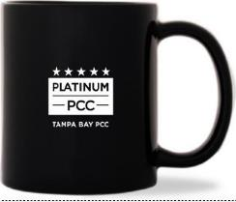
Local PCCs
New Initiatives
EDDM Membership Campaign
“PCC Membership Has It’s Perks!”
NMMP
New Member Mentor Program

Slide 14
Regional
Area Focus Groups
The Postal Service® shall support a forum in which to meet with members of the First Class, Periodicals and Standard Mail industries to discuss and seek solutions for service issues, share information and ideas, and provide opportunities to interface with industry and postal management. The Area Focus Groups will serve as a vehicle of communications between customers and the Postal Service advocating issues and supporting the needs of the First Class, Periodicals and Standard Mail industries.
USPS & Industry
Focus Group Calendar
Focus Group Co-chairs and Coordinators
https://ribbs.usps.gov/index.cfm?page=periodicalsfocus

Slide 15
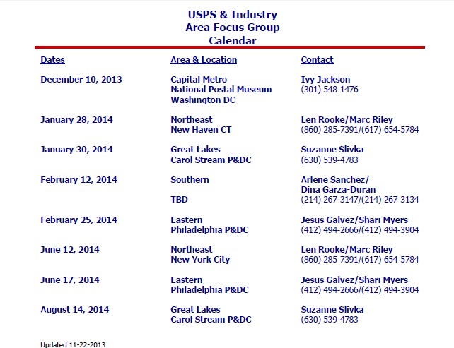
Regional
https://ribbs.usps.gov/index.cfm?page=periodicalsfocus

Slide 16
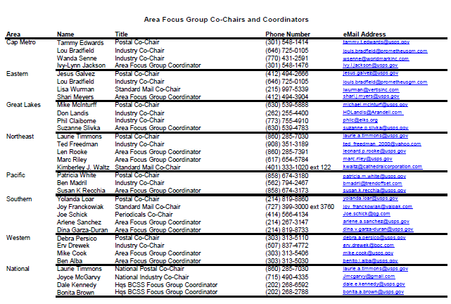
Regional
https://ribbs.usps.gov/index.cfm?page=periodicalsfocus

Slide 17
National
MTAC Membership Assembly/Focus Group Discussions
The Postmaster General's Mailers' Technical Advisory Committee (MTAC) is a venue for the United States Postal Service (Postal Service) to share technical information with mailers, and to receive their advice and recommendations on matters concerning mail-related products and services, in order to enhance customer value and expand the use of these products and services for the mutual benefit of Mailing Industry stakeholders and the Postal Service.
The next MTAC/Focus Group meeting is January 14-16, 2014. USPS Leadership Forum for Stakeholders and MTAC Meeting Dates in 2014 are:
        May 20-22, 2014
        August 19-21, 2014
        November 18-20, 2014

Slide 18
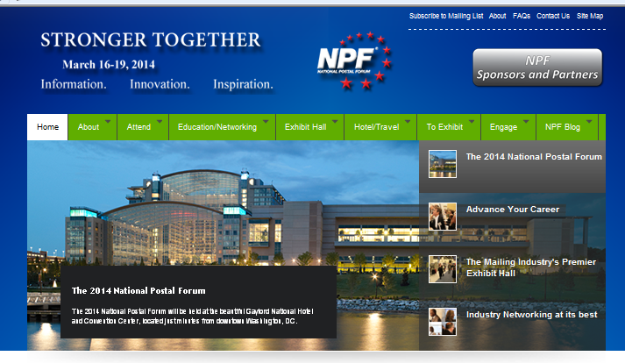
National
http://npf.org/

Slide 19
Personal ROI
“For the last twenty years I have participated in the Tampa Bay PCC in varying capacities. Initially, I simply attended events as a member and enjoyed learning about postal products and initiatives. I became interested in becoming a board member a few years later and can still remember the first Executive Board Meeting I ever attended. What struck me then still holds true today….the PCC is an invaluable resource for business mailers. I eventually served as the Secretary and several years later stepped into the role of Industry Co-Chair. Serving in this leadership role has helped me both professionally and personally. Not only have I learned a great deal about the USPS, I have forged friendships with so many wonderful people along the way. The PCC has enabled me to work closely with so many dedicated and knowledgeable postal employees. There is no greater resource for business mailers than the PCC and I am proud to lead such a exemplary Executive Board and to serve the members of the Tampa Bay PCC.”
Amy Rocha
Industry Co-Chair

Slide 20
Tampa Bay PCC Stories
Executive Board Member, Ann Elliott
  Began at Bramlett Direct Mail Services in 2006
  Invited by PCC Treasurer to attend PCC Meeting in 2007
  Joined the Tampa Bay PCC Executive Board in 2007
  Now Ann knows local Postmasters, Plant Managers, District Manager, BME Manager and Supervisors as well as a slew of mail industry folks
  Attended the National Postal Forum in 2009, 2011 and 2012
  Received Mail Design Professional Certification in 2012 via the Tampa Bay PCC
  Selected as Industry Vice-Chair of Tampa Bay PCC Executive Board in 2013
  Will be a presenter at the 2014 National Postal Forum along with Amy Rocha Co-Chair of Tampa Bay PCC

Slide 21
Now Tell Us Your Stories
Did your local PCC involvement help you get where you are today?
How?

